Slide 1

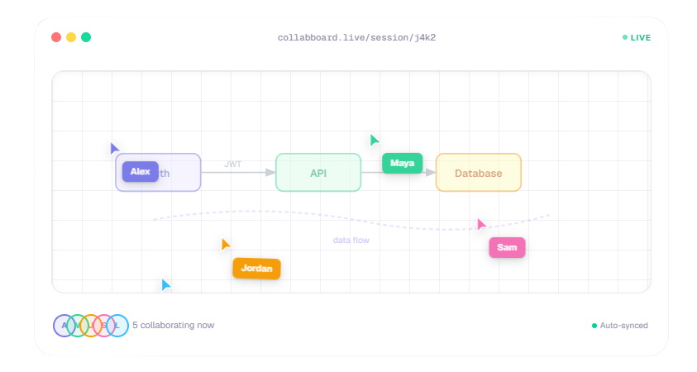
CollabBoard
Real-Time Collaborative Whiteboard & Code Editor Desktop Application
Happy Mishra | 0302CS221045
Nikita Pandey | 0302CS221068
Roshan Jain | 0302CS221111

Slide 2

What is CollabBoard?
A comprehensive desktop application and accompanying web platform designed for remote teams and developers.
Core Problem Solved
Eliminates the need to juggle separate apps for whiteboarding, code sharing, and video conferencing.
Two-Part Ecosystem
Desktop App: The core workstation powered by Electron.
Web Platform: A marketing, documentation, and distribution hub.

Slide 3


The Tech Stack
Frontend Ecosystem
React 18/19, Vite, Tailwind CSS, Framer Motion, GSAP.
Desktop Environment
Electron 39.
Backend & Infrastructure
Auth & Realtime: Supabase (Auth, Realtime channels).
Code Execution: Judge0 CE (via RapidAPI).
Video/Audio: PeerJS (WebRTC) + Metered.ca TURN server.
Core Integrations
tldraw (whiteboard), Monaco Editor (code).

Slide 4



Key Features
Real-Time Whiteboard: Synchronized drawing and presence using tldraw and Supabase.
Integrated Code Workspace: Monaco editor with live code execution via Judge0 and a professional terminal UI.
Seamless Access: Email/Google OAuth, persistent login, and a secure Guest/Offline mode.
Project Management: Create, rename, delete, and share projects instantly via generated room codes.

Slide 5
Custom WebRTC Meeting System
Peer-to-Peer Video: Built from scratch using PeerJS and Supabase Realtime signaling.
Reliable Connections: Metered.ca TURN server ensures connectivity across strict networks.
Advanced Controls: Dynamic video grid (1-6+ participants). Desktop screen sharing (via Electron desktopCapturer). In-meeting live chat.
UX Focused: Floating, draggable meeting window that minimizes to a pill so it never blocks the workflow.

Slide 6

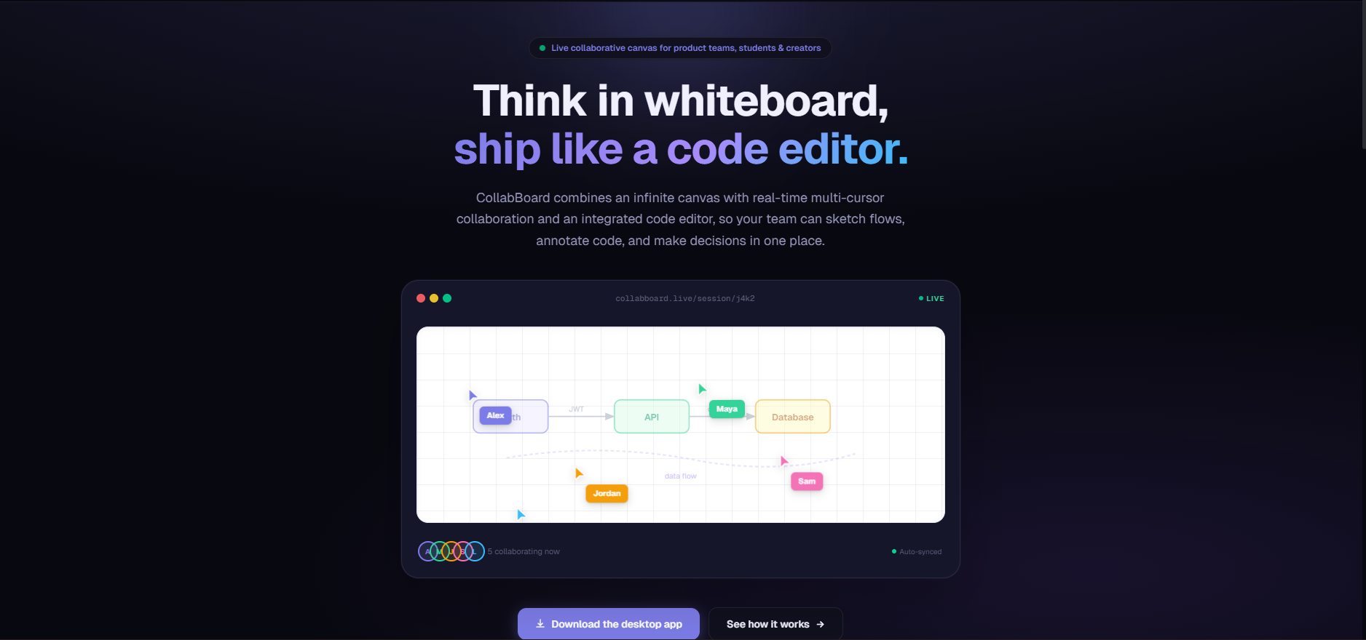

The Web Platform -
https://collabboard-web.vercel.app/

Slide 7
The Web Platform -
Dynamic Marketing Hub: Animated hero section with GSAP, custom cursors, and 3D hover effects.
Automated Changelog: Live GitHub Releases API feed to display updates in a vertical timeline.
Distribution: Direct downloads for Windows, macOS, and Linux formats.
SEO & Analytics: Fully optimized with GA4, Microsoft Clarity, and dynamic sitemaps.

Slide 8
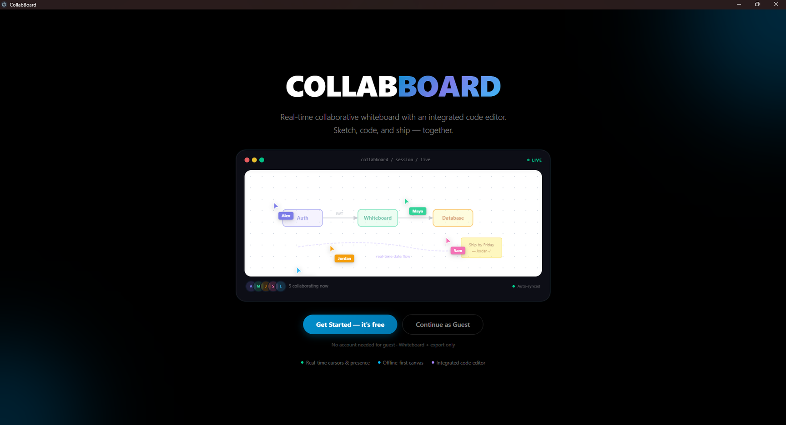
The Desktop Application -

Slide 9
The Desktop Application -
Unified Environment: An Electron-based powerhouse combining visual planning, coding, and communication into a single window.
Infinite Collaborative Canvas: Real-time whiteboard powered by tldraw and Supabase presence, allowing multiple users to sketch architectures simultaneously.
Integrated Execution Engine: Built-in Monaco code editor with live compilation via Judge0, featuring interactive standard input and a professional terminal UI.
Native OS Capabilities: Leverages Electron for direct clipboard access (bypassing browser restrictions) and seamless desktop screen sharing.
Floating Communication Hub: Custom WebRTC video calling that minimizes into a draggable, non-blocking widget, ensuring you never lose sight of your work.

Slide 10
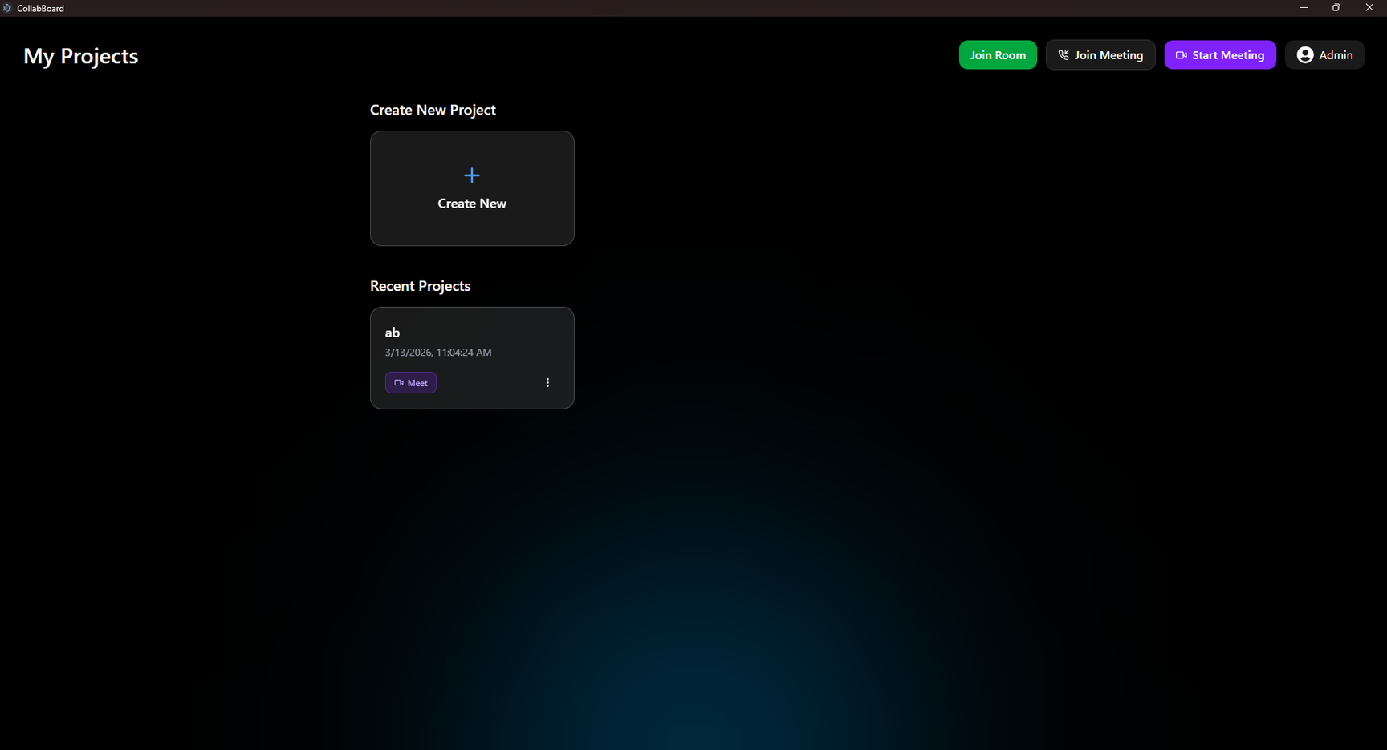

Slide 11
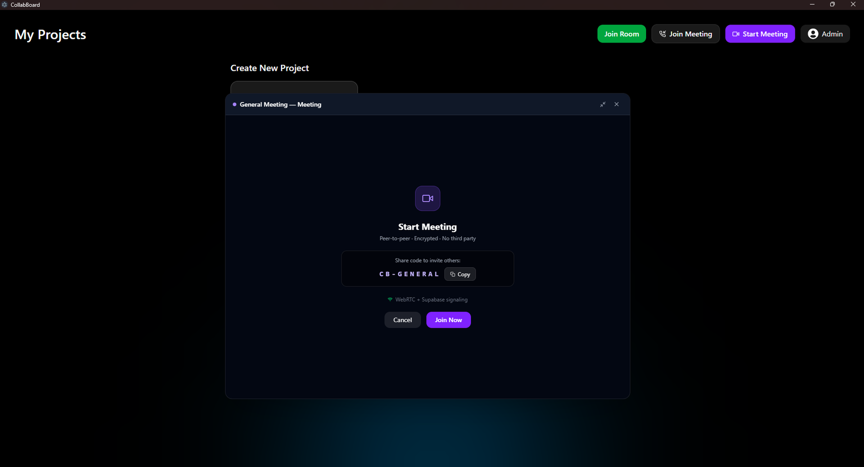

Slide 12
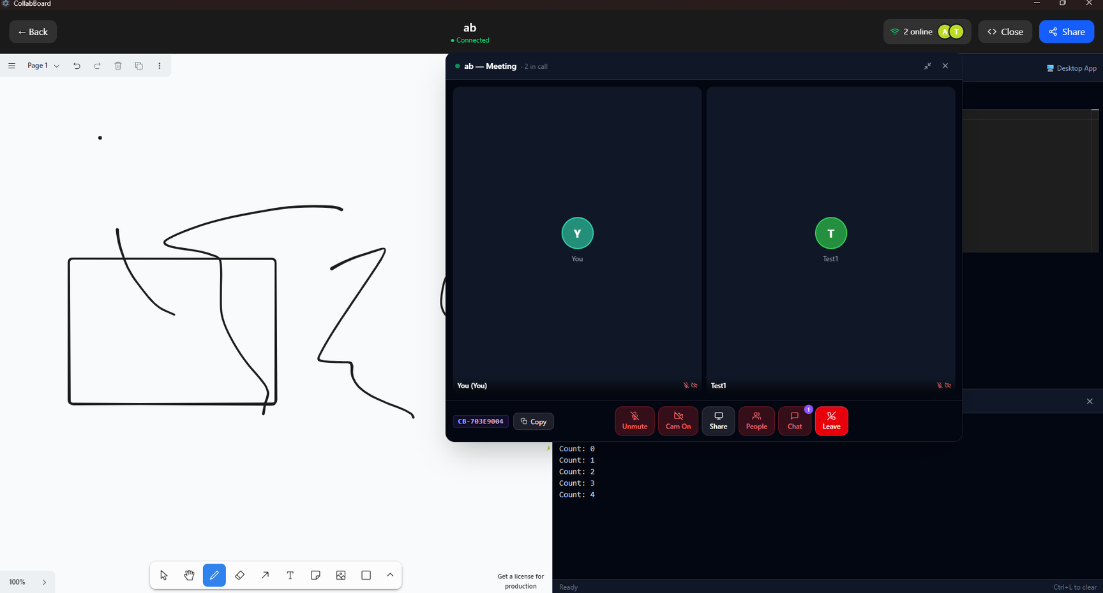

Slide 13
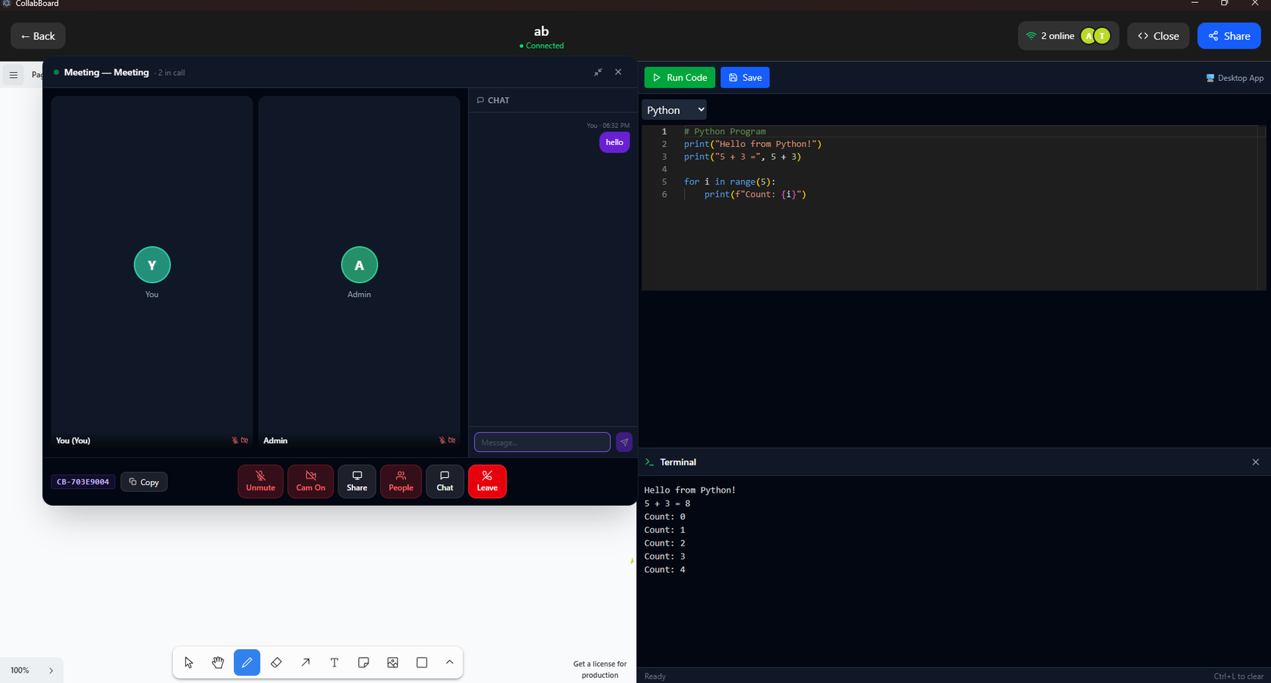

Slide 14
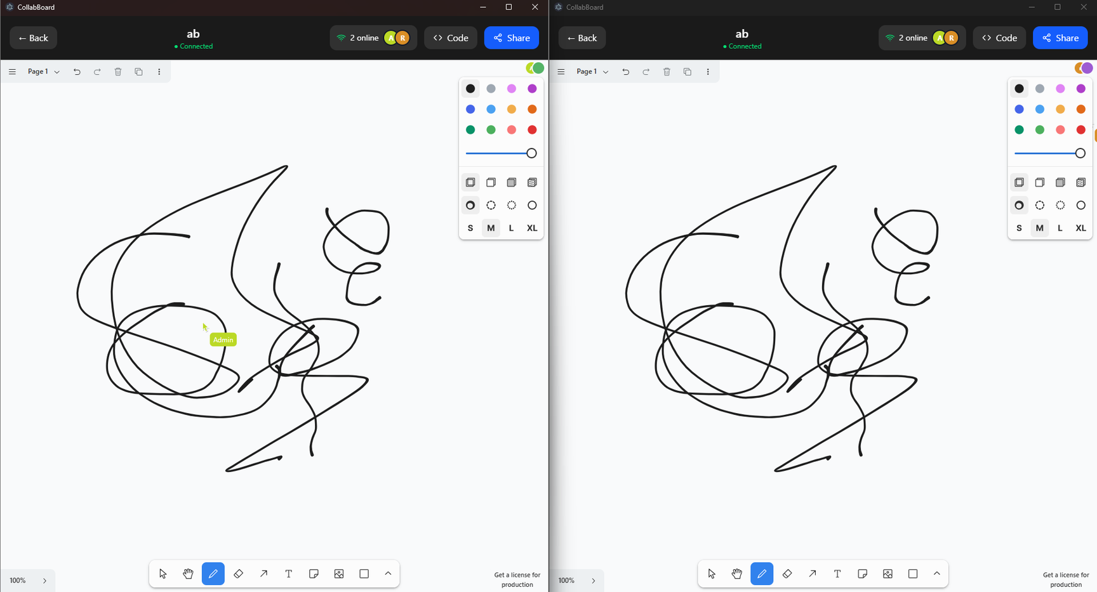

Slide 15


Thank You

